Slide 1
Flight Attitude Simulator
- Mounika Edula, Jayakrishnan HJ

Slide 2
Overview
Software Architecture
Communication interface
Demo
Features
Testing
Hardest Part to Implement
Epic Failures
Biggest Learning Point

Slide 3
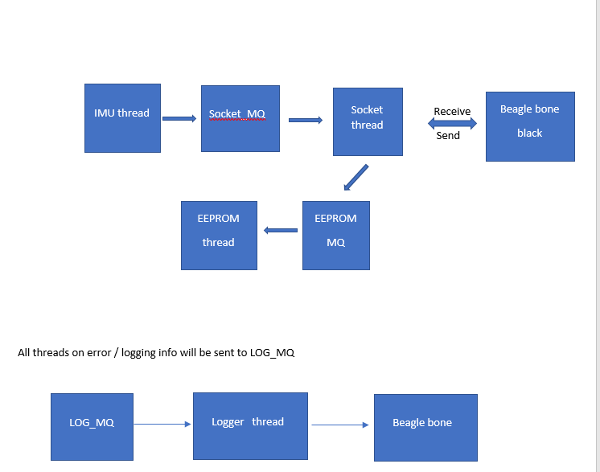
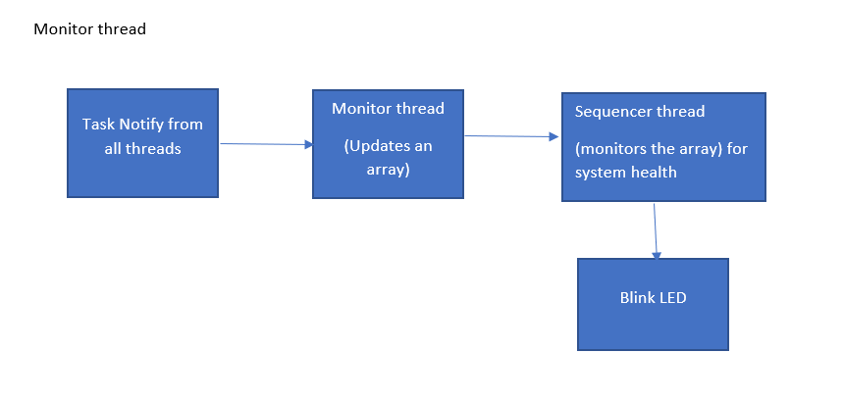
Software Architecture
Tiva TM4c1294 Side

Slide 4
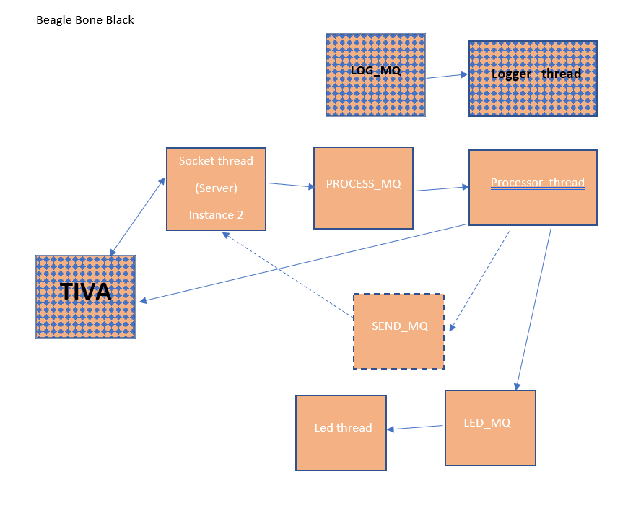
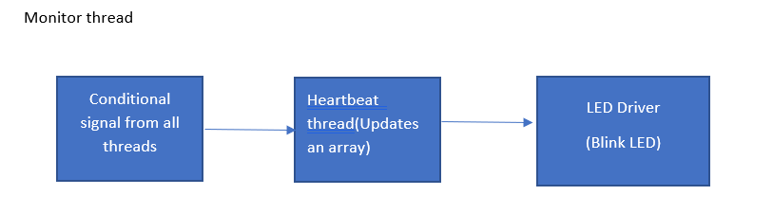
Software Architecture
BeagleBone side

Slide 5
Communication Interface
Sensors
IMU MPU-9250--(I2C interface)--Tiva
EEPROM--(HAL)—Tiva
Feedback based Actuation
4 LEDs –GPIO—BeagleBone
Message type
Typedef Struct { float(x_ddot, y_ddot, z_ddot, pitch_dot, roll_dot, yaw_dot)}IMU_data_t;
Typedef Struct {uint8_t ( LED1, LED2, LED3, LED4)}LED_t;
Typedef Union {IMUdata_t IMUdata, LED_t LED, char logger_data[SIZE]}data_t;
Typedef Struct { status_t status, state_t state, char timestamp[SIZE], data_t data}message_t;
All queues transport messages of type message_t.

Slide 6
Demo

Slide 7
Example Logging information
Timestamp [Type of message] Message

Slide 8
Testing
Ensured IMU value by observing the acceleration value. One value has to be g.
EEPROM: wrote out and read the same value
Tested LED in loopback and used LED blink for feedback
We tested UART in loopback mode (minicom) in BBG

Slide 9
Hardest Part to Implement & Epic Failure
LWIP sockets

Slide 10
Worst Bug
Different data rates
I2C sampling and acquisition rates

Slide 11
Biggest Learning Point
Interfacing different Operating Systems
Having a fall back plan

